Slide 1
Shri Guru Gobind Singhji Institute of Engineering and Technology
Department of Information Technology
Topic : Predicting hand sign digits using Deep Learning
Presented By: Divyank Patil (2020BIT017)
Amit Pandhare (2020BIT038)
Aashutosh Karale (2020BIT054)
Shlok Ingle (2020BIT068)
Under the Guidance of: Prof. Rachna Potpelwar

Slide 2
Table of contents
01
02
03
04
05
06
Introduction
Objectives
Methodology
Code
Analysis
Conclusions

Slide 3
Introduction
Sign languages (also known as signed languages) are languages that use manual communication to convey meaning.
This can include simultaneously employing hand gestures, movement, orientation of the fingers, arms or body, and facial expressions to convey a speaker's ideas.
Sign languages are full-fledged natural languages with their own grammar and lexicon.
01

Slide 4
Objectives
The overarching problem we aim to address involves improving accessibility and understanding for Deaf and hard-of-hearing individuals through the study of sign languages.
Despite the significance of sign languages, there are existing challenges in areas such as education, communication, and inclusion that our analysis seeks to contribute solutions to.
Our ultimate goal is to create a deep learning model that generates accurate predictions on the Hand Sign Digits Datasets.
02

Slide 5
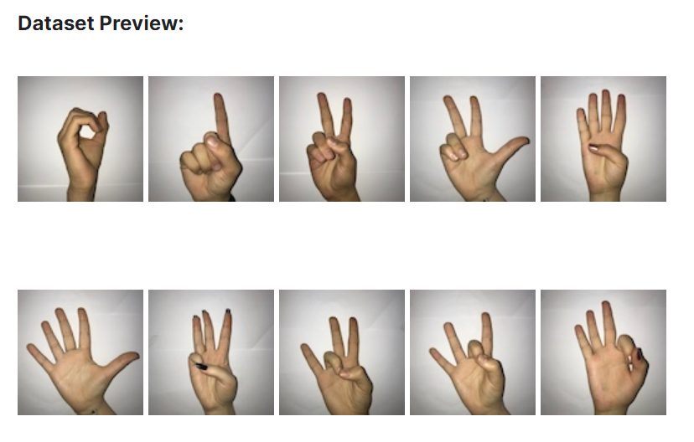
Details of Dataset
https://www.kaggle.com/datasets/ardamavi/sign-language-digits-dataset
Image Size: 64 × 64
Colorspace: Grayscale
File Format: npy
Number of classes: 10 (Digits 0 - 9)
Number of Participant Students: 218
Number of Samples per Student: 10
Total Samples: 2180
03

Slide 6
Methodology
Split Dataset into Train and Test Data.
Reshape Images to fit them to Convolution.
Build a CNN Architecture.
Execute the model for appropriate number of epochs .
Depict Loss vs. Validation Loss on line chart.
Depict Accuracy vs. Validation Accuracy on line chart.
Generate predictions on Test Data.
Compute Confusion Matrix and Classification Report.
04

Slide 7
Code

Slide 8
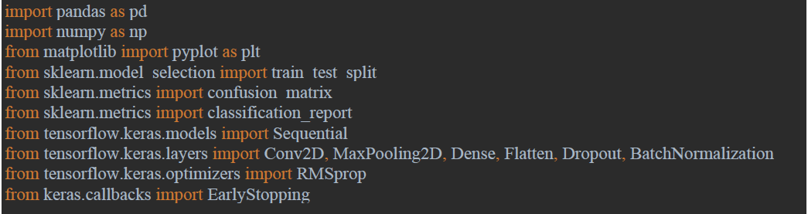
Importing Libraries
The code begins by importing necessary libraries, including pandas, numpy, matplotlib, and scikit-learn for data manipulation, visualization, and machine learning tasks.
It also imports specific modules from TensorFlow and Keras, which are popular frameworks for building and training neural networks.
5.1

Slide 9
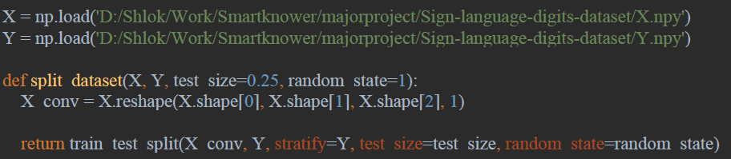
Loading Data and Splitting Data
The next step loads the dataset, which is stored in two NumPy arrays - X (features/images) and Y (labels). The dataset contains images of sign language digits.
The split_dataset function is defined to split the dataset into training and testing sets. It reshapes the image data to be compatible with the CNN model.
5.2

Slide 10
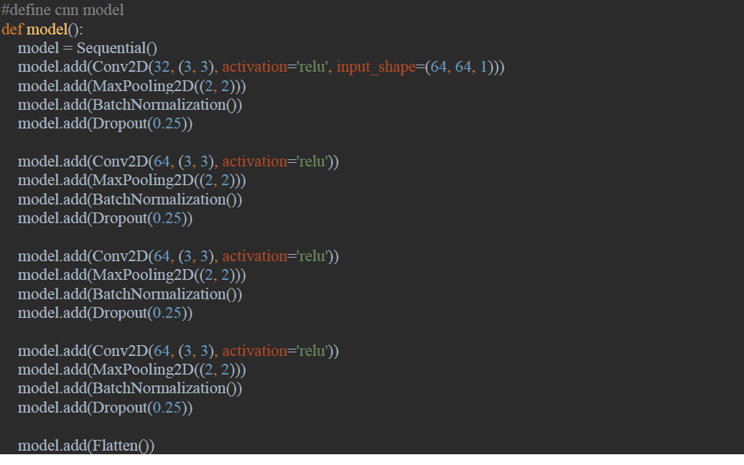
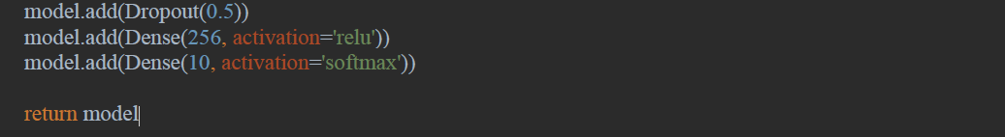
Define CNN Model
The model function defines the architecture of the Convolutional Neural Network.
It consists of convolutional layers with activation functions, max-pooling layers, batch normalization, dropout layers to prevent overfitting, and fully connected (dense) layers.
5.3

Slide 11
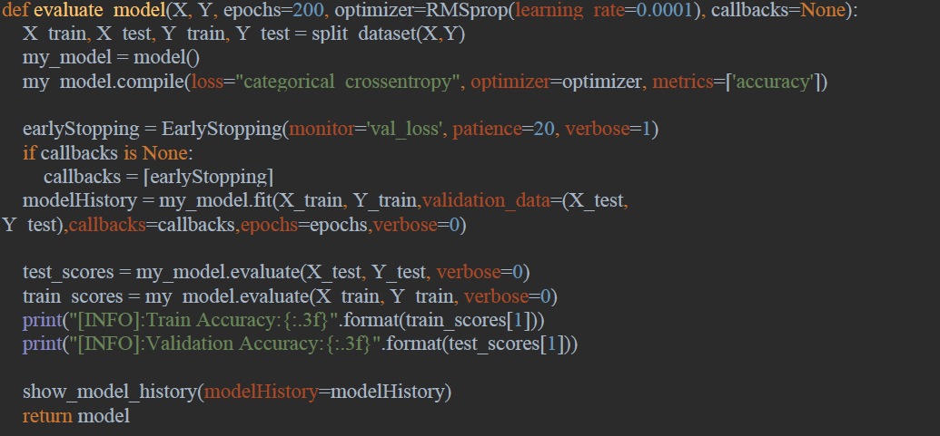
Model Training and Evaluation
The evaluate_model function splits the data, compiles the defined CNN model, and then trains the model on the training set while validating on the test set.
It prints the training and validation accuracy and loss, and it uses early stopping to prevent overfitting.
5.4

Slide 12
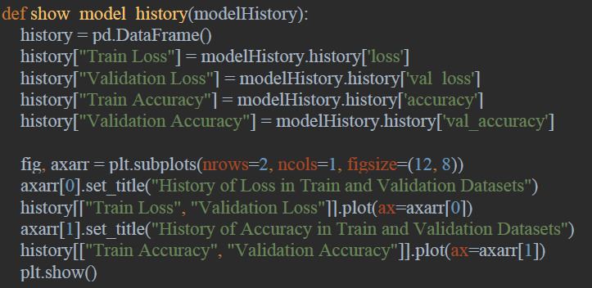
Model Training and Evaluation
The training history is visualized using the show_model_history.
This function is designed to visualize the training history of a neural network, specifically focusing on loss and accuracy over epochs for both the training and validation datasets. The plot helps in assessing how well the model is learning from the training data and how it generalizes to new, unseen data during validation.
5.5

Slide 13
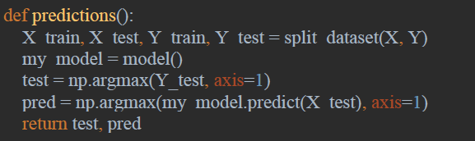
Model Predictions and Evaluation Metrics
The predictions function splits the data, initializes the model, and makes predictions on the test set.
The overall performance of the model is assessed using a confusion matrix and a classification report, providing insights into how well the model is classifying different sign language digits.
5.6

Slide 14
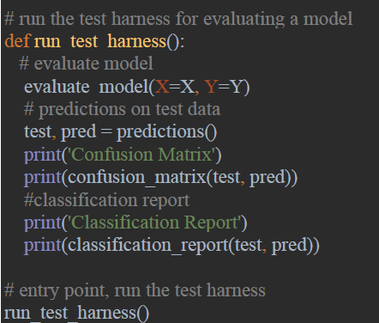
Test Harness
The run_test_harness function is the entry point, calling the evaluate_model function to train and evaluate the model, and then using the predictions function to display the confusion matrix and classification report.
5.7

Slide 15
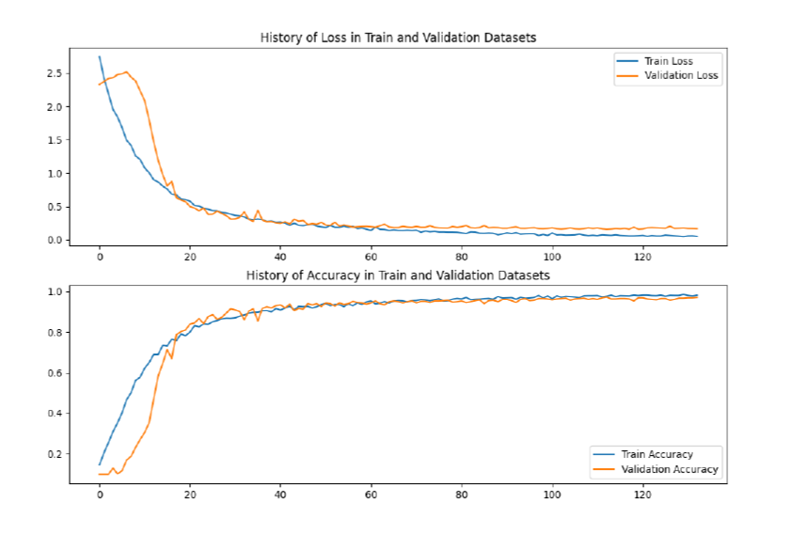
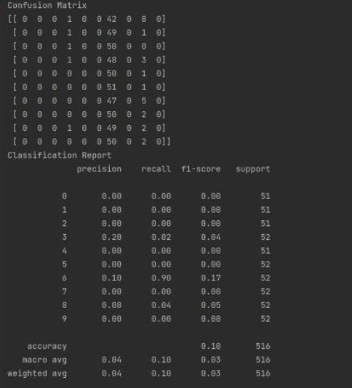
Analysis
Confusion Matrix and Classification Report
Line Chart
06

Slide 16
Conclusions
We have built a CNN architecture that correctly identifies the sign language digits for >97% of validation accuracy.
Despite the high validation accuracy, the classification report does not reflect so considering that the total data samples are only about 2200, out of which 75% is train data.
The train data is randomized hence the predictions for only a few digits are more accurate than the others.
This can be avoided if we go for repeated cross validation of these results, which would generate better reports, but still might be victim to overfitting owing to the overlapping subsets.
07

Slide 17
Thank You!

